Slide 1
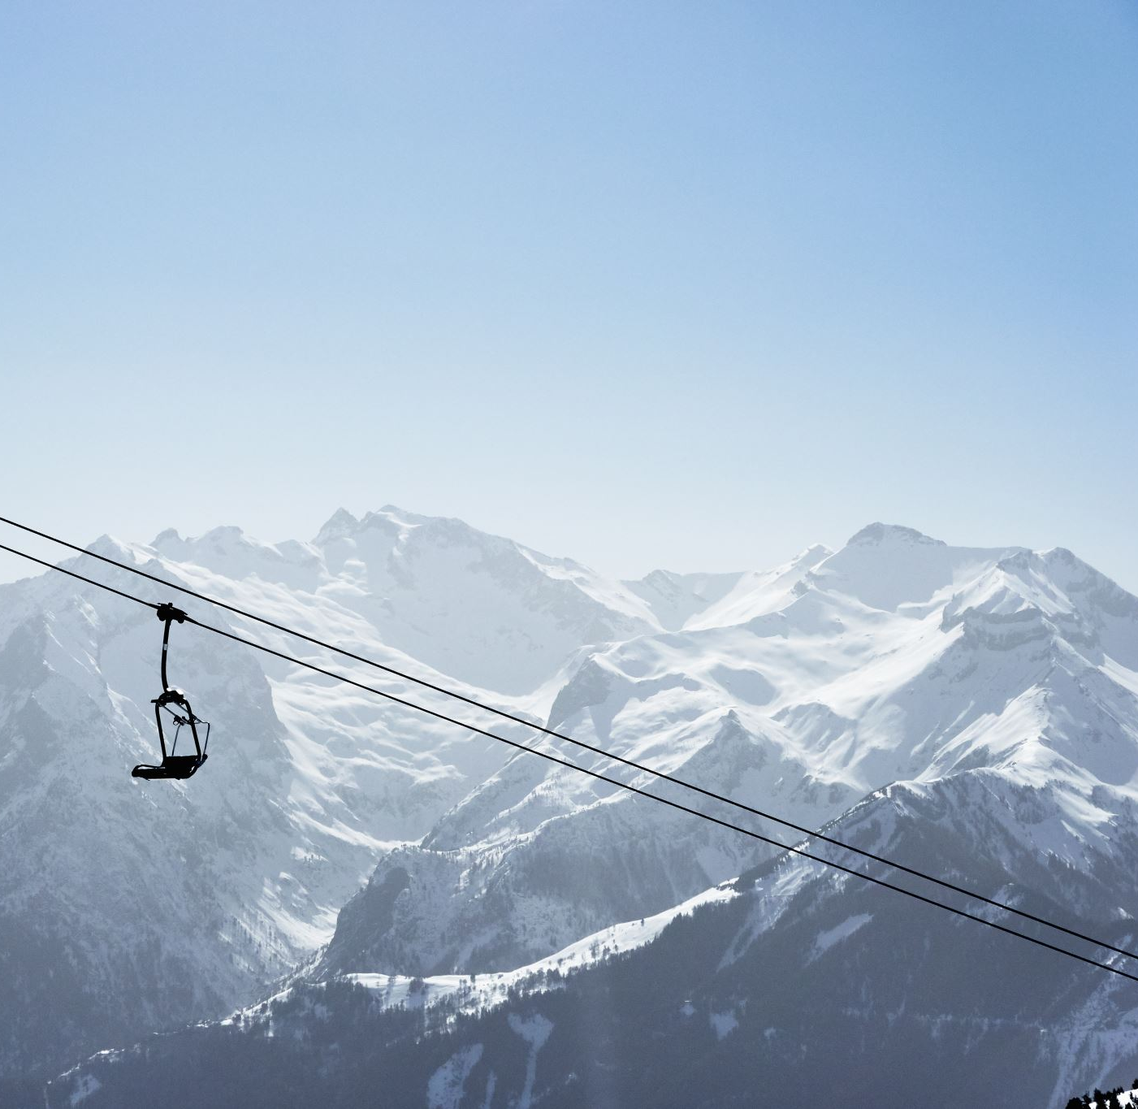
Big Mountain Resort
Maximizing profits using a data-driven pricing model tested against market segment

Slide 2
What is our current model? What is our problem?
Big Mountain Resort charges a premium ticket price because Big Mountain offers premium features!
One of these features is a brand-new chair lift
It has a projected operational cost of $1.5mil
But here’s the problem… What is the actual value of our premium features?
Does our price accurately reflect this premium?
Does our premium price pay for the operational costs of these features?
Our prices are justifiably higher than other resort’s prices in the state of Montana

Slide 3
How do we choose the right price?
Quantize the value of our features by designing and implementing a model that correlates high impact features with ticket prices
Predict our maximal ticket price using the model
Justify our price with the data that indicates our share of high impact features in the market
Maintain our new price and reduce operational cost by eliminating features that have a low impact on price. At the minimum, we should offset the operational cost of our new lift
We need to build a model that determines the price of each feature and scale it to the ticket price. We’re going to assume our number of visitors stays the same.

Slide 4
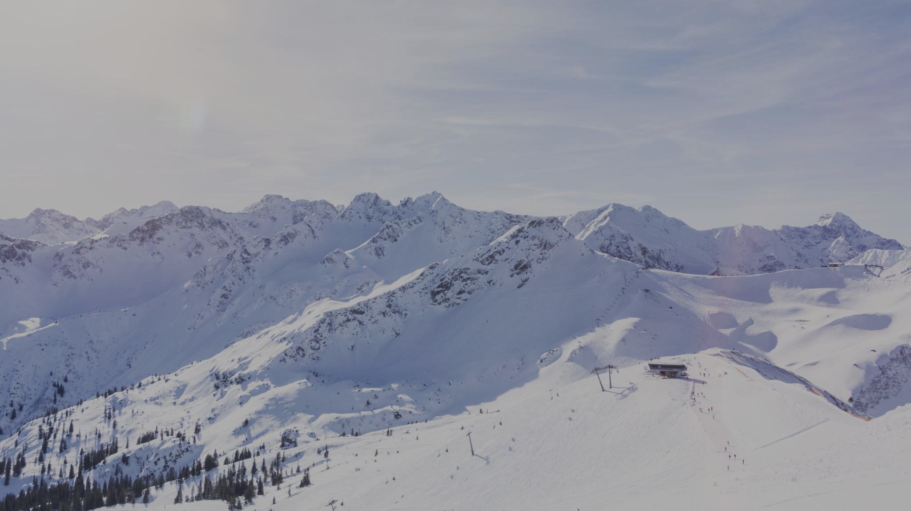
Among ski resorts in the nation, Big Mountain outshines most!
In fact, the model predicts that the ticket price for Big Mountain resort should be $95.
Big Mountain ranks in the upper echelon among resorts in America in the categories:
• Number of fast quads • Number of runs • Acres covered by snow makers
• Maximum vertical drop • Acres of skiable terrain • Total chair lifts
As it turns out, these are the features that customers are willing to spend the most for, so raising the ticket price is advisable and justifiable.

Slide 5
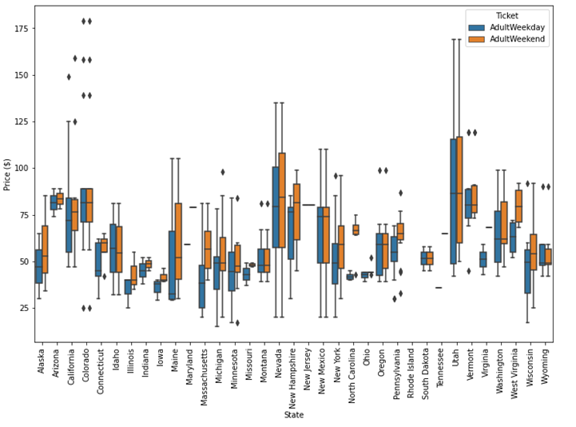
Determining our market: Is the ski resort market state specific?
The series of boxplots (shown left) indicates that ticket price distributions vary significantly by state.
Notice that Montana’s ticket price distribution has much less variation than some states, and a relatively low median.
You may notice that the data points for Big Mountain ($81) are outliers for the state.
In order to justify raising ticket prices, we must confirm that we can justify treating all states equally in our model.
In the next slide, we will see that a principal components analysis provides justification for not separating the market by state.

Slide 6
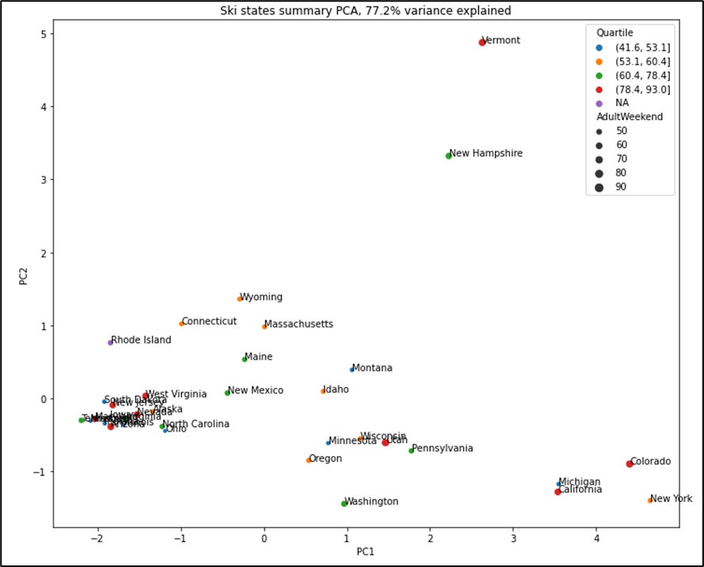
Testing for state-wise clustering: Principal components analysis
The figure of the right shows the projection of state market segment onto a two-dimensional plane
The color and size of point indicates the average ticket price of that state
The data appears to cluster around the bottom left corner
This cluster does not indicate any similarity in pricing quartile, indicated by the variety of blue, green, and red points
Vermont and New Hampshire stand out along component 2’s axis
Explained by the high ratio of resorts per capita and resorts per square mile
Belong to different pricing quartiles, indicating no clear pricing relationship
No other clear clustering
All states are determined to be a part of one unified market segment.

Slide 7
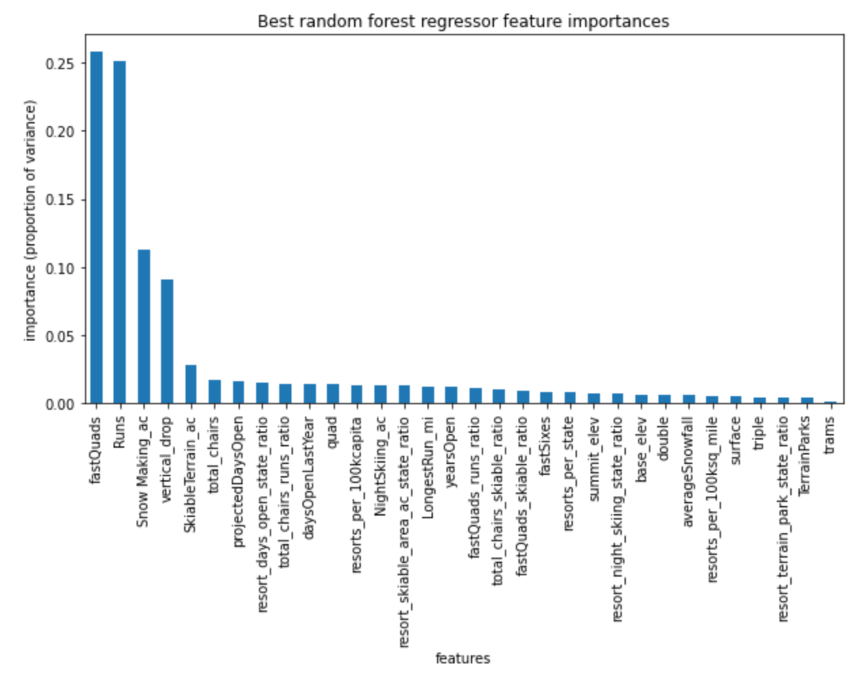
Identifying significant features that impact ticket prices across resorts nation-wide
We tested a linear regression and random forest model against a 70/30 test/train split of the data and verified the validity of the model using a 5-fold cross validation. The random forest model with best parameters yielded higher cross validation scores with less variation, so we proceeded with that model. The features shown right were ranked in order of importance to the predicted ticket price.

Slide 8
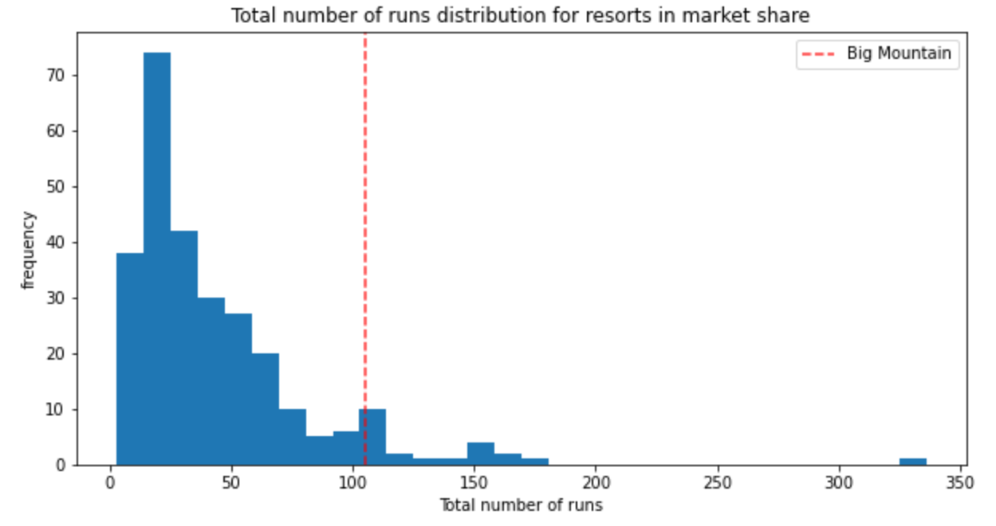
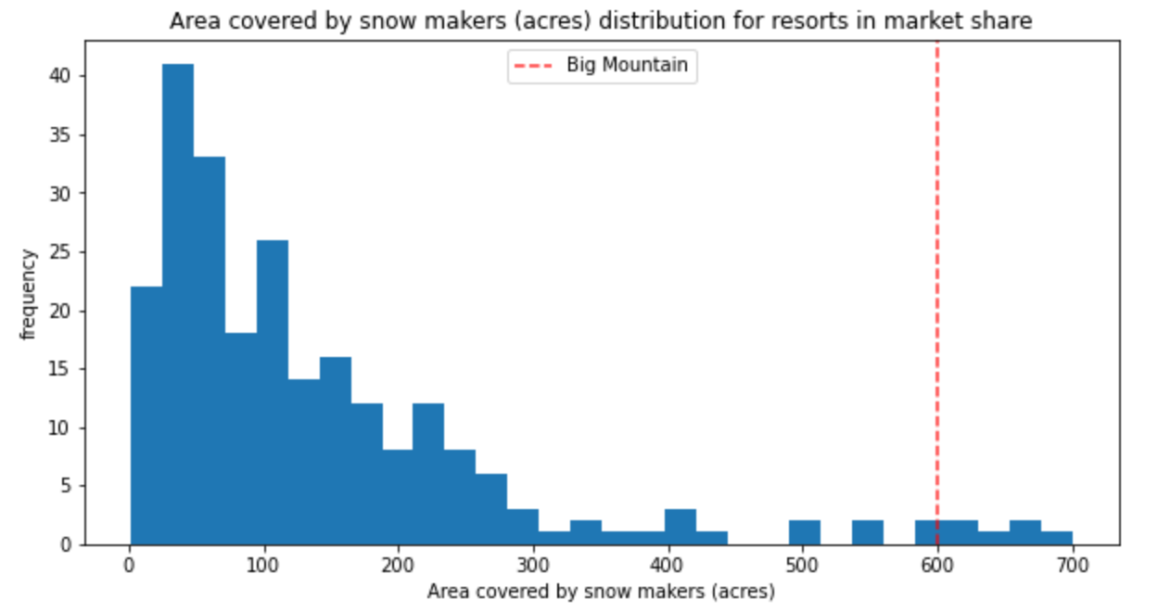
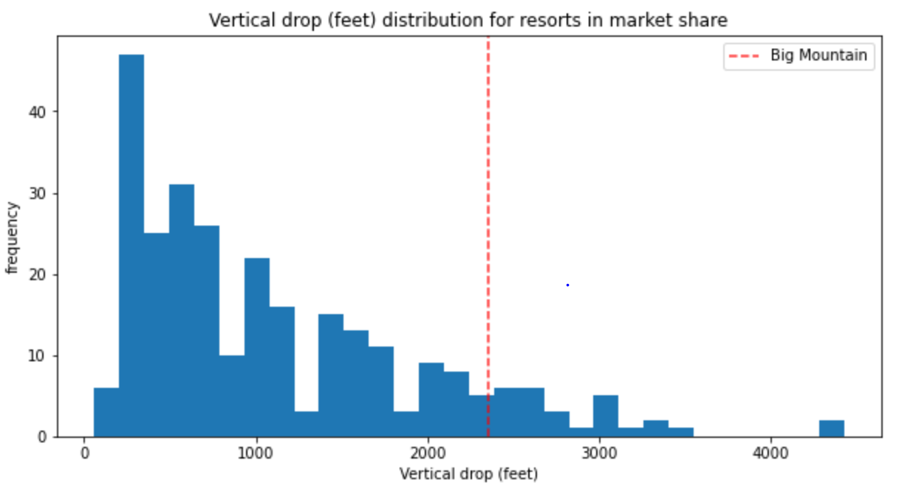
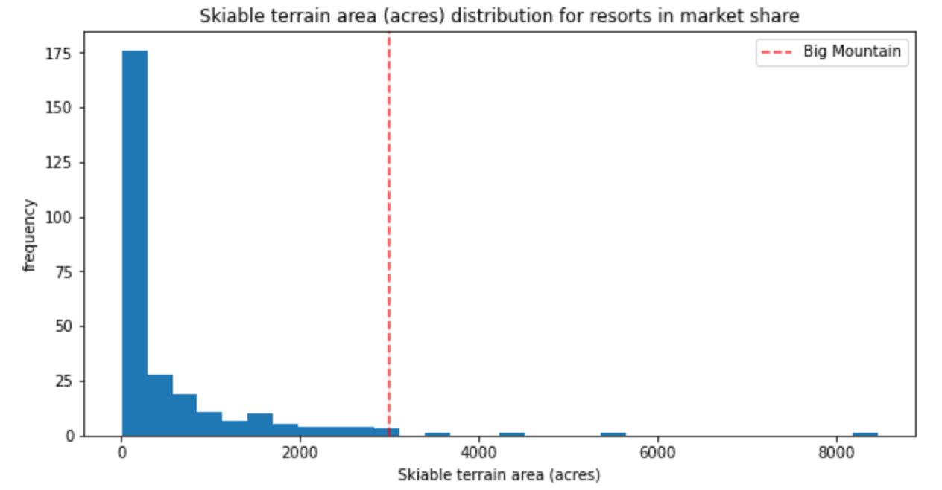
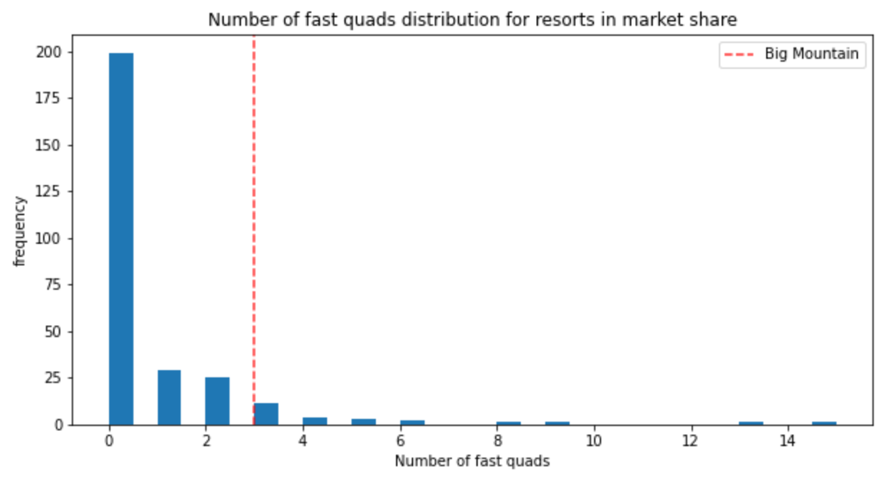
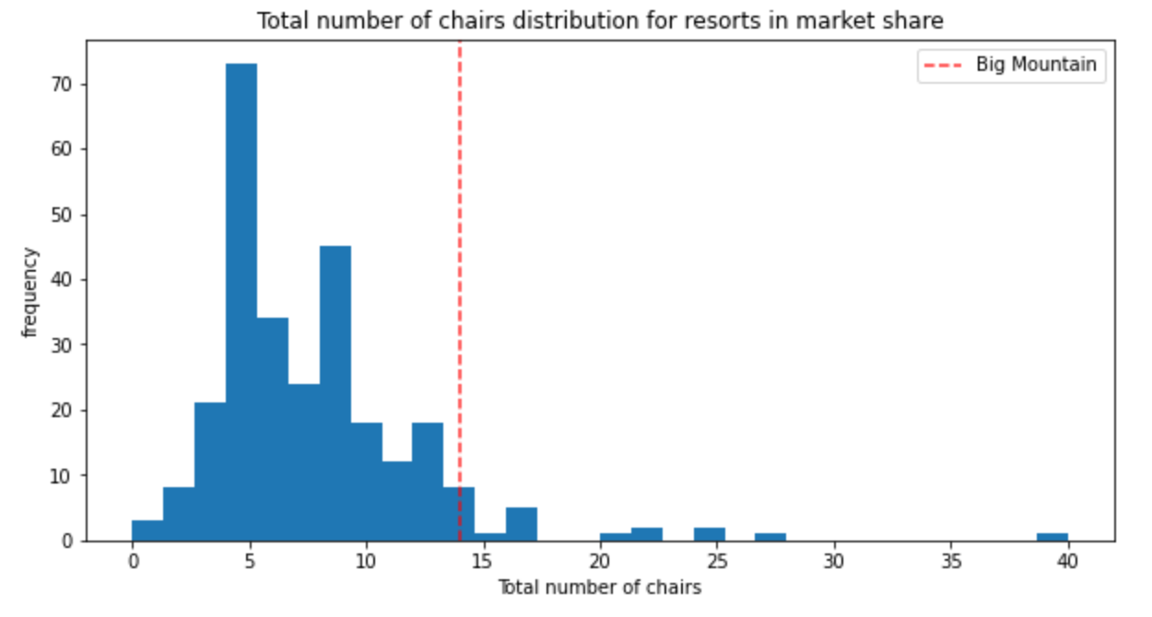
How does Big Mountain rank for the most important features?

Slide 9
Conclusion
Big Mountain has the features to back up premium pricing
It stands up to the most premium and most expensive resorts in the market.
A ticket price of $95 is justifiable
This would solve the initial problem of recouping the operational cost of the new lift
The model can also be used to reassess the prediction when features are changed
This can inform decisions were removing features to reduce operational cost.
My recommendation for reducing operational cost is to remove one existing run
Reduces operational cost without affecting revenue
My recommendation for maximizing key price features is to create a new run to increase vertical drop by 150
Modifying an existing chair lift rather than building a new one for the run is advised

